Slide 1
Finite State Machine
-- Sakshi Surve

Slide 2
Definition of DFA
Deterministic Finite automata or DFA is defined as
M = ( Q , Σ , δ , q₀ , F )
Where
Q is a finite set of internal states
Σ is a finite set of symbols called the input alphabet
δ : Q X Σ → Q is a Total Function called Transition Function
q₀ is an initial state q₀ ε Q
F is a set of final states F ⊆ Q

Slide 3
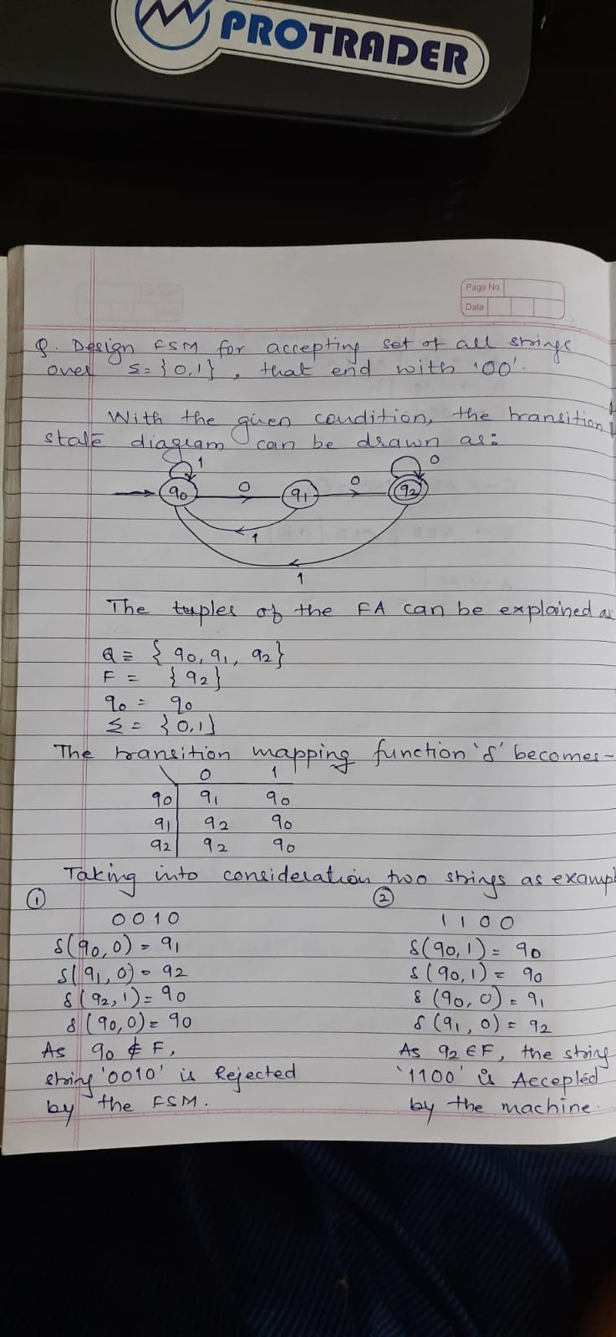

Slide 5
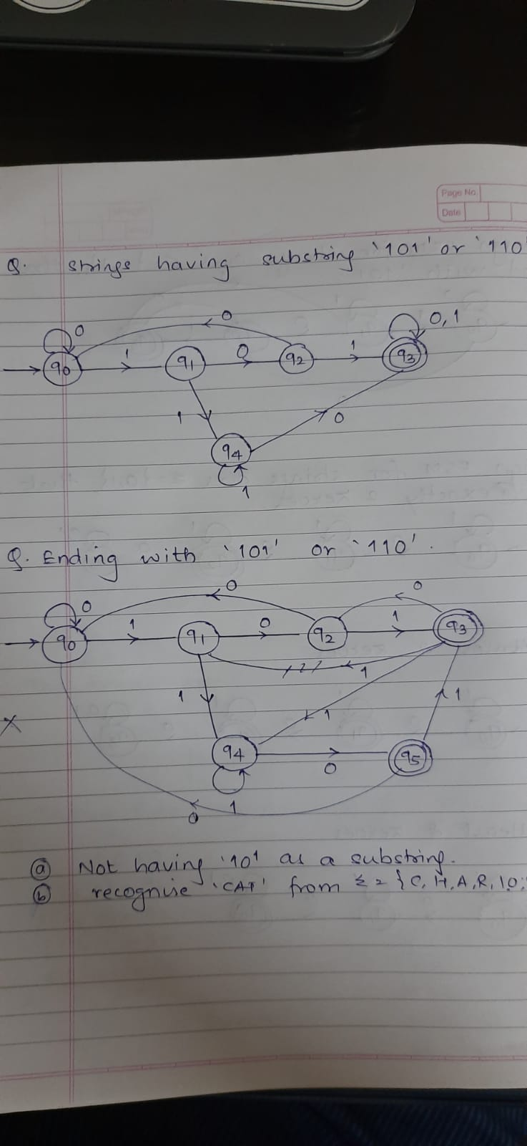
Design an FSM for strings containing ‘101’ or ‘110’ as substrings

Slide 6
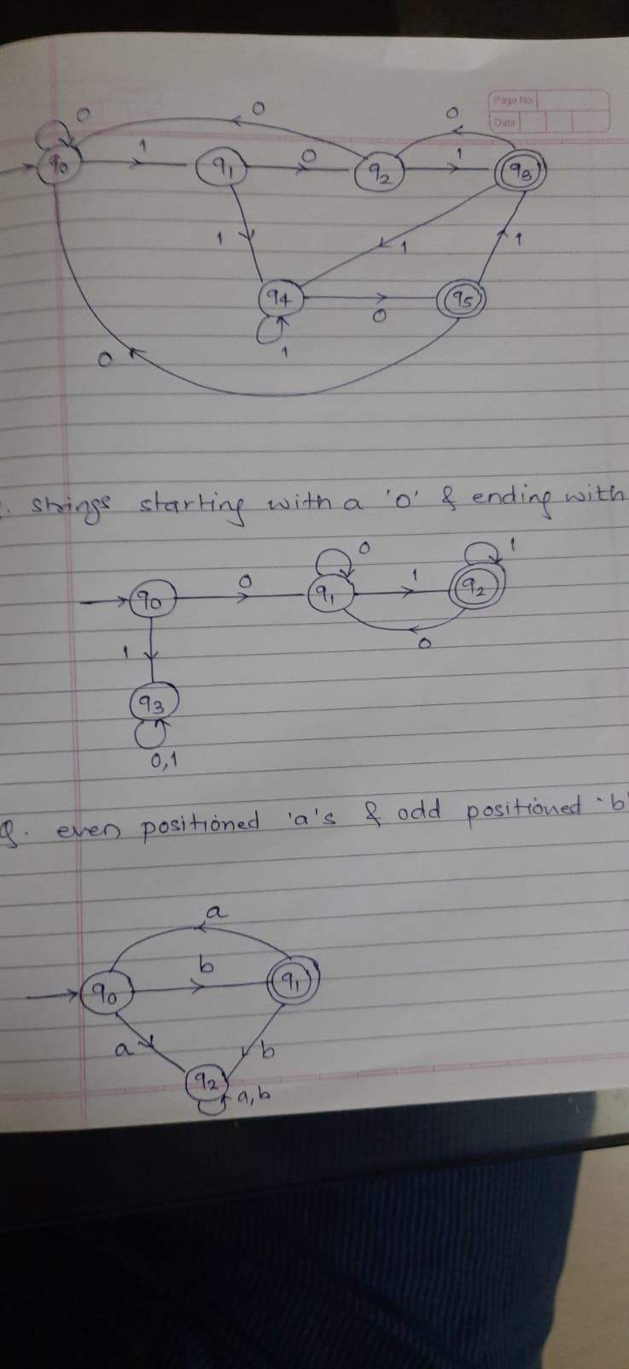
Design an FSM for strings ending with ‘101’ or ‘110’

Slide 7
FSM for Stings starting with a ‘0’ and ending with a ‘1’

Slide 8
FSM for Stings starting with even positioned ‘a’s and odd positioned ‘b’s

Slide 9
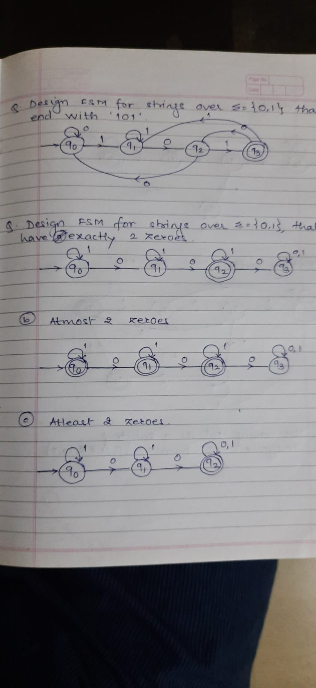

Slide 12
Homework :
FSM for strings Not having ‘101’ as a substring
FSM for recognizing substring ‘CAT’ from input symbols {‘C’, ‘H’, ‘A’, ‘R’, ‘I’, ‘O’, ‘T’ }

Slide 13
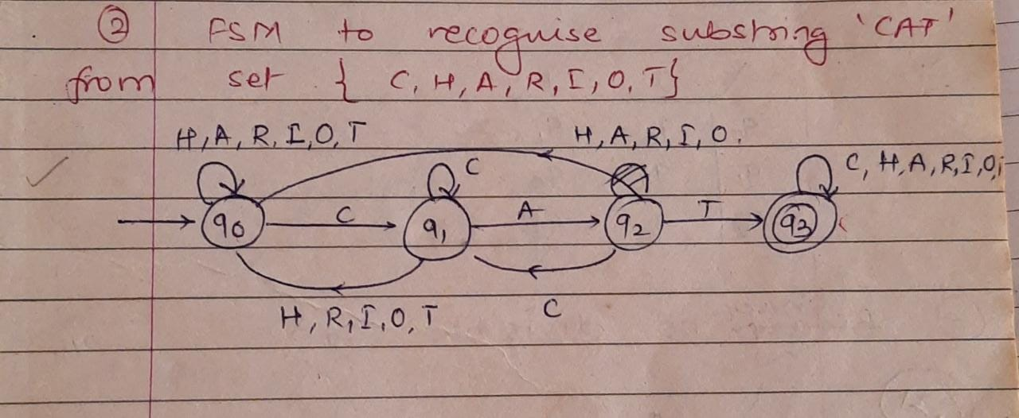

Slide 14
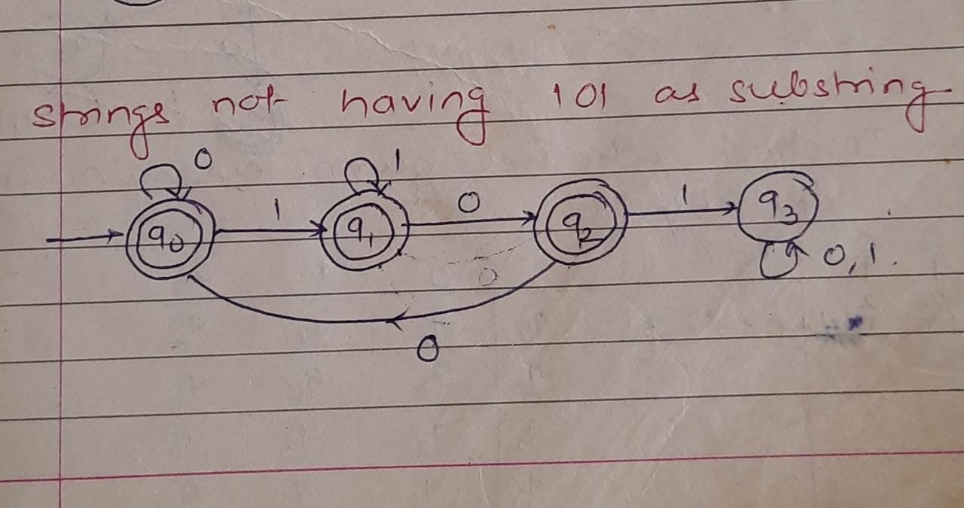

Slide 15
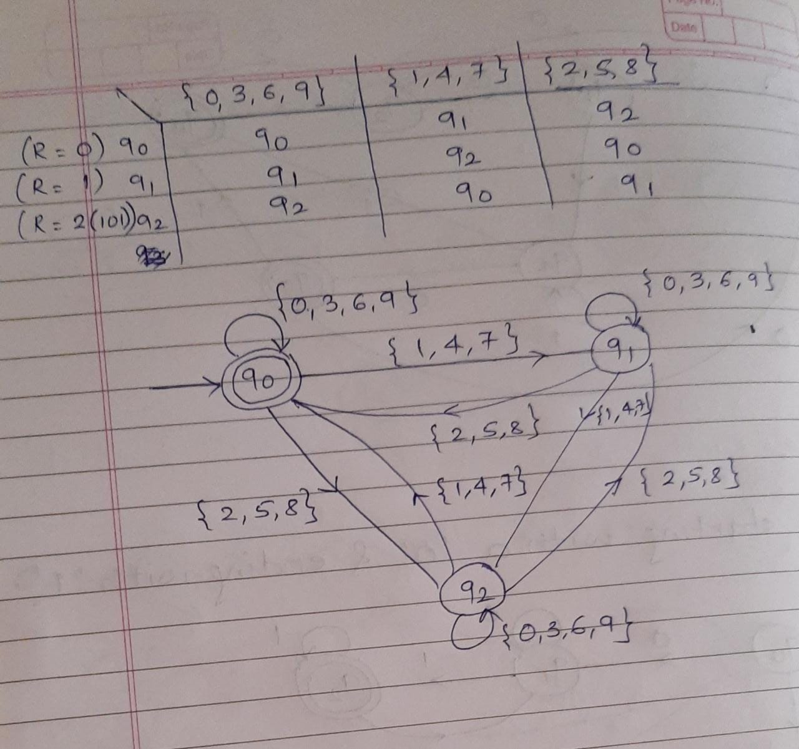
FSM for checking whether a decimal number is divisible by 3

Slide 17
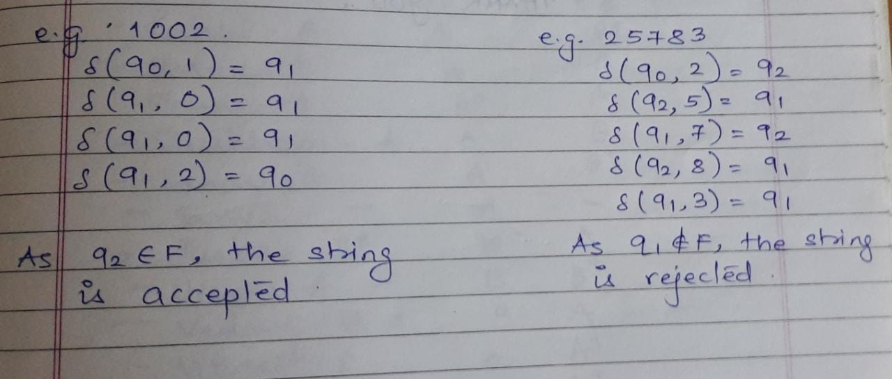

Slide 18
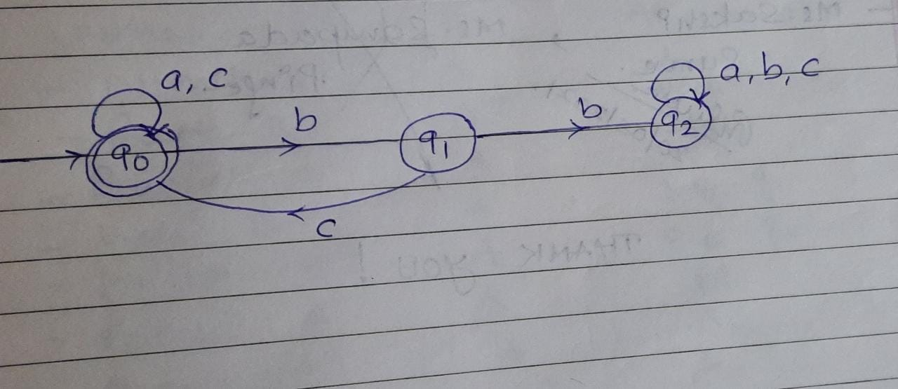
Design FSM to accept language
L={x € {a, b, c} * | Every ‘b’ in x is immediately followed by ‘c’ }

Slide 19
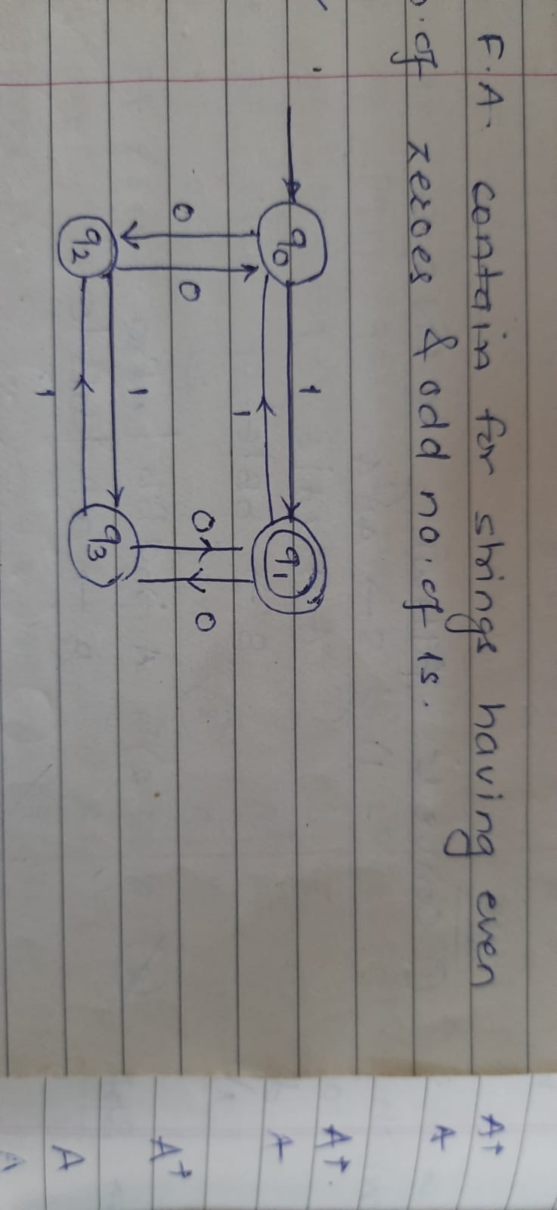
FMS to accept even number of 0’s and add number of 1’s

Slide 20
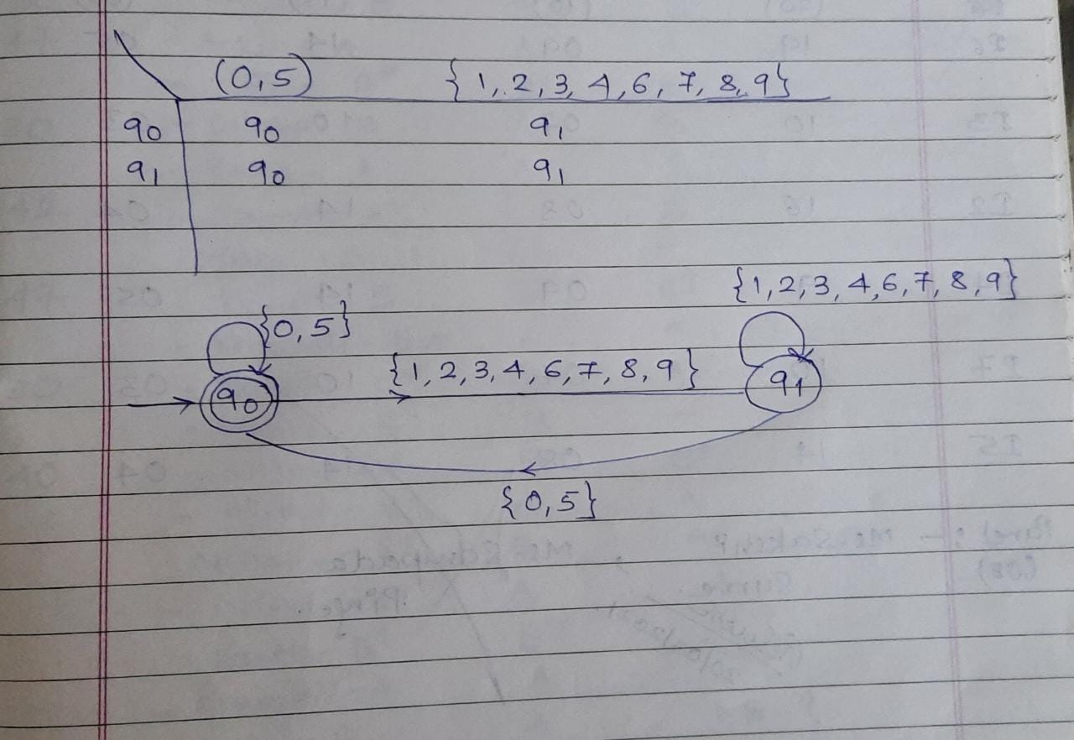
FSM to check divisibility of a decimal number by 5

